Slide 1

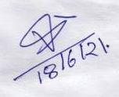


Date : 10/06/2021
This is to certify that the thesis entitled “Department store billing system ” given by M.K Institute of Computer Studies which is been submitted by
1. Vikram somai
surendra rawat
in Partial Fulfillment for the VIth Semester of Bachelor of Computer Application of Veer Narmad South Gujarat University (VNSGU) has been carried out by them under my supervision.
The project is done using PHP MY SQL tools.
(paresh Prajapati) (Mr. Vijesh J Shukla)
Internal Guide

Slide 2


A project on
DEPARTMENT STORE BILLING SYSTEM
Submitted for Partial Fulfil for the Degree of:
BECHELOR OF COMPUTER APPLICATION [BCA]
[6th SEMESTER, TYBCA]
Year: 2020-2021
Submitted to:
M. K. INSTITUTE OF COMPUTER STUDIES BHARUCH
Vikram somai ROLL NO:18B074 surendra rawat ROLL NO:18B098
INTERNAL GUIDE: MR. PARESH PRAJAPATI

Slide 3
INDEX
Sr .No. | Content | Page No.
1. | Project Description | 3
 | 1.1 Profile | 4
 | 1.2 Definition
 | 1.3Description
2. | Project Planning | 5
 | 2.1 Scope
 | 2.2. Goal | 6
 | 2.3 Constraints | 7
3. | Environment Description | 8
 | 3.1 Technologies | 9
 | 3.2 Software and hardware Requirements | 10
 | 3.3 PHP introduction | 11
 | 3.4 Introduction of SQI | 19
 | 3.5 Introduction Jquery | 23
 | 3.6 Introduction PhP mailer | 26
4. | System Description
 | 4.1 Data Gathering | 29
5. | Objectives and Advantages of system | 30
 | 5.1 Objective of system | 31
 | 5.2 Advantages of system | 32
 | 5.3 waterfall model | 33
6. | 6.1 Database Design | 40
 | 6.2 Data Dictionary | 46
 | 6.3Data Flow Diagram | 49
7. | System modules
 | 7.1Scren modules | 55
8. | System testing | 64
9. | Future enhancement | 70
10. | Bibliography | 71

Slide 4
PROJECT DESCRIPTION
A department billing software open source is a business solution being used by supermarket, retail stores, and more. On the other hand, with this, businesses can automate their repetitive tasks to reduce wastage and provide exceptional shopping experience to customers. In addition to billing, most supermarket billing systems also aid in accounting and inventory-related processes. If you are a supermarket business that has presence across different locations, then this is suitable for you. As it provides single interface for managing these different supermarkets. In other words, by use of supermarket billing software, you can streamline the business of stores spread across the country. “Billing system” is an application to automate the process of ordering and billing of a Departmental store This web-based application is designed considering the chain of departmental store which is located in various cities. This application also administrates its users and customers

Slide 5
PROJECT PROFILE
Project Name: | Department store billing system
Developed by: | Vikram somai 18b074 Surendra rawat 18b098
College Details: | Name: M.K. Institute of computer studies Address: Old NH-8,Collage Campus, Bharuch,392001 Phone:02642-225637 Email-id:mkinstitute@gmail.com Website: www.mkics.in
Internal Guide: | Mr. Paresh (Asst ..Pro)
Front End: | HTML,CSS,JAVASCRIPT
Back End: | PHP,MYSQL

Slide 6
project planning
scope
1)This project will help the store keeper in fast billing.
2) This project enables store keeper to maintain a great database of all Customers visited and purchase product from store.
3)Project will enable to see report regarding product and category.
4) It is easy to maintain in future prospect.

Slide 7
Goal
To reduce the billing burden that is done manually.
Provide customer improved billing experience.
To give proper marketing satisfaction to the customers
To provide organized or categorized product bill to the customer.
To provide different methods of payment to the customers.
Customers might pay you with cash, credit cards or, if you offer it, an instalment plan.
Regardless of how they pay, you'll need a billing system to invoice and track customer orders.
Billing systems often are designed to handle everything from computing charges to providing statements.

Slide 8
Constraints
This system is used for making payments.
The mode of payment can be cash or cashless
This makes the payment secure
This can be used by all the retailers

Slide 9
Environment description
technologies
TECHNOLOGIES AND TOOLS Software Used in the system
1) Web browser: Google Chrome
2) Languages Used: php.
3) Notepad++ (for compiling and executing the programs)
4)Hardware Used: CPU configuration - AMD processors 4000+ series - RAM 1 GB DDR2 Monitor - Any monitor
5) Operating System: - Windows XP - Windows 7 - Windows 8 Or any other version

Slide 10
HARDWARE SPECIFICATION
processor | Pentium iv
speed | 1.7 GHZ
Memory capacity | 1GB
Hard disk capacity | 1 TB
monitor | dell

Slide 11
SOFTWARE SPECIFICATION
Operating system | Windows 10
Web server | xamp
Data base | MySQL
Enterprise application | J2ee, jboss
Implementation architecture | Mve,3 tier using servlet,jspj
Scripting language | Java script
Programming language | php

Slide 12
Introduction
What is PHP
PHP is an open-source, interpreted, and object-oriented scripting language that can be executed at the server-side. PHP is well suited for web development. Therefore, it is used to develop web applications (an application that executes on the server and generates the dynamic page.).
PHP is a recursive acronym for "PHP: Hypertext Pre processor".
PHP is a server-side scripting language that is embedded in HTML. It is used to manage dynamic content, databases, session tracking, even build entire e-commerce sites.
It is integrated with a number of popular databases, including MySQL, PostgreSQL, Oracle, Sybase, Informix, and Microsoft SQL Server.
PHP is pleasingly zippy in its execution, especially when compiled as an Apache module on the Unix side. The MySQL server, once started, executes even very complex queries with huge result sets in record-setting time.
PHP supports a large number of major protocols such as POP3, IMAP, and LDAP. PHP4 added support for Java and distributed object architectures (COM and CORBA), making n-tier development a possibility for the first time

Slide 13
Characteristics of php
Five important characteristics make PHP's practical nature possible −
Simplicity
Efficiency
Security
Flexibility
Familiarity

Slide 14
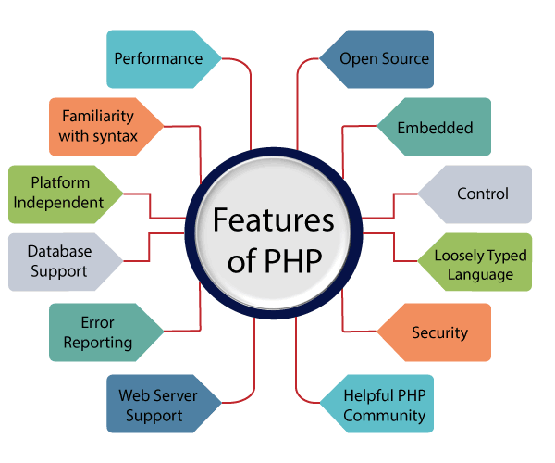
CHARACTERISTICS OF PHP

Slide 15
Performance
PHP script is executed much faster than those scripts which are written in other languages such as JSP and ASP.
PHP uses its own memory, so the server workload and loading time is automatically reduced,
which results in faster processing speed and better performance.
Open Source
PHP source code and software are freely available on the web. You can develop all the versions of PHP according to your requirement
without paying any cost. All its components are free to download and use.
Familiarity with syntax
PHP has easily understandable syntax. Programmers are comfortable coding with it.
Embedded
PHP code can be easily embedded within HTML tags and script.

Slide 16
Platform Independent:
PHP is available for WINDOWS, MAC, LINUX & UNIX operating system. A PHP application developed in
one OS can be easily executed in other OS also.
Database Support:
PHP supports all the leading databases such as MySQL, SQLite, ODBC, etc.
Error Reporting -
PHP has predefined error reporting constants to generate an error notice or warning at runtime.
E.g., E_ERROR, E_WARNING, E_STRICT, E_PARSE.
Loosely Typed Language:
PHP allows us to use a variable without declaring its datatype. It will be taken automatically at the time of execution
based on the type of data it contains on its value.
Web servers Support:
PHP is compatible with almost all local servers used today like Apache, Netscape, Microsoft IIS, etc.
Security:
PHP is a secure language to develop the website. It consists of multiple layers of security to prevent threads and malicious attacks.
Control:
Different programming languages require long script or code, whereas PHP can do the same work in a few lines of code
. It has maximum control over the websites like you can make changes easily whenever you want.

Slide 17
Why use PHP
PHP is a server-side scripting language, which is used to design the dynamic web applications with MySQL database.
It handles dynamic content, database as well as session tracking for the website.
You can create sessions in PHP.
It can access cookies variable and also set cookies.
It helps to encrypt the data and apply validation.
PHP supports several protocols such as HTTP, POP3, SNMP, LDAP, IMAP, and many more.
Using PHP language, you can control the user to access some pages of your website.
As PHP is easy to install and set up, this is the main reason why PHP is the best language to learn.
PHP can handle the forms, such as - collect the data from users using forms, save it into the database, and return useful information to the user. For example - Registration form.

Slide 18
Advantage of php
Open source:
It is developed and maintained by a large group of developers. This will help in creating a support community and abundant extension libraries.
Speed:
It is relatively fast, since it uses not much system resources.
Easy to use:
It uses a C like syntax, so for those who are familiar with C, it’s very easy for them to pick up and easy to create website scripts.
Stable: Since it is maintained by many developers, bugs are rather found and fixed quickly, making it a stable software.
Powerful library support:
You can easily find functional modules you need such a PDF, graph etc.
Built in database connection modules:
You can connect to databases easily using PHP, since many websites are data/ content driven, so we will use database frequently, this will largely reduce the development time of web apps.

Slide 19
Community Support: A huge advantage the technology has is its community. If you are looking for a particular script, chances are another user has already created something similar. Check within the community for availability. Likewise, if you have created a function that other’s might enjoy, be sure to post the code for others.
Security: It offers security that can prevent malicious attacks. This can be adjusted for example in the .ini file.
Talent Availability: You can hire programmers with this technology skill more easily than any other language programmers since so many people know the language.
Bright Future: Although PHP is already well established, its future prospects are infinite. The keynote is that PHP is loosely typed. This makes simple scripts much faster to develop. One has to devote much less energy towards design.

Slide 20
Introduction to mysql
MySQL is an open-source relational database management system (RDBMS). It is the most popular database system used with PHP. MySQL is developed, distributed, and supported by Oracle Corporation.
The data in a MySQL database are stored in tables which consists of columns and rows.
MySQL is a database system that runs on a server.
MySQL is ideal for both small and large applications.
MySQL is very fast, reliable, and easy to use database system.It uses standard SQL
MySQL compiles on a number of platforms.

Slide 21
MySQL is a database system used for developing web-based software applications.
MySQL used for both small and large applications.
MySQL is a relational database management system (RDBMS).
MySQL is fast, reliable, and flexible and easy to use.
MySQL supports standard SQL (Structured Query Language).
MySQL is free to download and use.
MySQL was developed by Michael Widenius and David Axmark in 1994.
MySQL is presently developed, distributed, and supported by Oracle Corporation.
MySQL Written in C, C++.

Slide 22
ADVANTAGES OF MYSQL
Data Security
MySQL is globally renowned for being the most secure and reliable database management system used in popular web applications including WordPress, Drupal, Joomla, Facebook and Twitter. The data security and support for transactional processing that accompany the recent version of MySQL can greatly benefit any business, especially if it is an eCommerce business that involves frequent money transfers.
On-Demand Scalability
MySQL offers unmatched scalability to facilitate the management of deeply embedded apps using a smaller footprint, even in massive warehouses that stack terabytes of data. On-demand flexibility is the star feature of MySQL. This open-source solution allows complete customization to eCommerce businesses with unique database server requirements.
High Performance
MySQL features a distinct storage-engine framework that facilitates system administrators to configure the MySQL database server for a flawless performance. Whether it is an eCommerce website that receives a million queries every single day or a high-speed transactional processing system, MySQL is designed to meet even the most demanding applications while ensuring optimum speed, full-text indexes and unique memory caches for enhanced performance.

Slide 23
Round-the-Clock Uptime
MySQL comes with the assurance of 24×7 uptime and offers a wide range of high-availability solutions,
including specialized cluster servers and master/slave replication configurations.
Comprehensive Transactional Support
MySQL tops the list of robust transactional database engines available on the market.
With features such as complete atomic, consistent, isolated, durable transaction support; multi-version transaction support;
and unrestricted row-level locking, it is the go-to solution for full data integrity.
It guarantees instant deadlock identification through server-enforced referential integrity.
Complete Workflow Control
With an average download and installation time of less than 30 minutes, MySQL means usability from day one.
Whether your platform is Linux, Microsoft, Macintosh or UNIX, MySQL is a comprehensive solution with self-management features
that automate everything from space expansion and configuration to data design and database administration.

Slide 24
Introduction j query
jQuery is an open source JavaScript library that simplifies the interactions between an HTML/CSS document
jQuery is widely famous with its philosophy of “Write less, do more.” This philosophy can be further elaborated as three concepts:
Finding some elements (via CSS selectors) and doing something with them (via jQuery methods) i.e. locate a set of elements in the DOM, and then do something with that set of elements.
Chaining multiple jQuery methods on a set of elements
Using the jQuery wrapper and implicit iteration

Slide 25
What You Can Do with jQuery
There are lot more things you can do with jQuery.
You can easily select elements to perform manipulation.
You can easily create effect like show or hide elements, sliding transition, and so on.
You can easily create complex CSS animation with fewer lines of code.
You can easily manipulate DOM elements and their attributes.
You can easily implement Ajax to enable asynchronous data exchange between client and server.
You can easily traverse all around the DOM tree to locate any element.
You can easily perform multiple actions on an element with a single line of code.
You can easily get or set dimensions of the HTML elements.

Slide 26
Advantages of Using jQuery
Save lots of time — You can save lots of time and efforts by using the jQuery inbuilt effects and selectors and concentrate on other development work.
Simplify common JavaScript tasks — jQuery considerably simplifies the common JavaScript tasks. Now you can easily create feature rich and interactive web pages with fewer lines of codes, a typical example is implementing Ajax to update the content of a page without refreshing it.
Easy to use — jQuery is very easy to use. Anybody with the basic working knowledge of HTML, CSS and JavaScript can start development with jQuery.
Compatible with browsers — jQuery is created with modern browsers in mind and it is compatible with all major modern browsers such as Chrome, Firefox, Safari, Internet Explorer, etc.
Absolutely Free — And the best part is, it is completely free to download and use.

Slide 27
Introduction to php Mailer
PHP Mailer is a class library for PHP that provides a collection of functions to and send email messages. PHP Mailer supports several ways of sending email: mail (), Send mail, Gmail & direct to SMTP servers. You can use any feature of SMTP-based e-mail, multiple recipients via to, CC, BCC. etc… In short: PHP Mailer is an efficient way to send e-mail within PHP.
PHP has a built-in mail () function. So why use PHP Mailer? Isn't it slower? Not really, because before you can send a message you have to construct one correctly, and this is extremely complicated because there are so many technical considerations.
PHP Mailer makes it easy to send e-mail, makes it possible to attach files, send HTML e-mail, etc. With PHP Mailer you can even use your own SMTP server and avoid Send mail routines used by the mail () function on UNIX platforms.

Slide 28
PHP Mailer is a code library to send (transport) emails safely^{[8]} and easily via PHP code from a web server .
Sending emails directly by PHP code requires a high-level familiarity to SMTP protocol standards (RFC 821, 2821, 5321) and related issues (such as Carriage return) and vulnerabilities about Email injection for spamming. From 2001 PHP Mailer is one of the popular solutions for these matters on PHP.
Sending E-Mail through PHP can be simple, or it can be very complex depending on what you want to do. A standard plain-text E-Mail is what most developers resort to because building the MIME headers for HTML mail can be a difficult process. Those days have been over for quite some time with the amazing PHP Mailer library that is available for free! In this tutorial, I will discuss in detail the features and possibilities you have when dealing with PHP Mailer.

Slide 29
Features
Plain text, HTML and multipart batched files.
SSL and TLS (Secure Sockets Layer and Transport Layer Security)
SMTP, Q mail, POP3.
Debugging system.
PHP send mail and mail methods.
IDN.
DKIM

Slide 30
Data Gathering
data gathering is used to made sure that no details are left, and that the requirement specification is fully details.
Possibly details are gathering about all the input and how the input and how the input are to be used for generating output and what are the input needed to generate the desired output.
All the privileges have been confirmed.
Their view of the system was taken into the consideration.
Example records were taken from the client to determine what the client exactly need the output to be and what the client expects from the website.
A detailed set of document had been prepared to show the exact output and the inputs to the client to make things sure and to show the limitations of the system.

Slide 31
Objective and Advantages of System
Objectives
Add and maintain records of available products.
Add and maintain customer details.
Add and maintain description of new products.
Add and maintain new entered category of products.
Provides economic/financial reports to the owner monthly or weekly and yearly.
Provides a convenient solution of billing pattern.
Make an easy to use environment for users and customers.

Slide 32
Advantages
Reducing long queues
Saving time
Track billing
Customer Invoices
Employee work hours
Expenses related to Clients
Immediate updates
Swift notifications plus reminders
Affordable and cost-effective

Slide 33
Manages expenses record
Depreciates Conflicts and Manual Errors
Creates Brand Identification
Simplifies statements
Enables 24*7 service
Builds brand professionalism
Reduces Manual labour

Slide 34
Waterfall diagram
Waterfall Model - Design
Waterfall approach was first SDLC Model to be used widely in Software Engineering to ensure success of the project. In "The Waterfall" approach, the whole process of software development is divided into separate phases. In this Waterfall model, typically, the outcome of one phase acts as the input for the next phase sequentially.
The following illustration is a representation of the different phases of the Waterfall Model.

Slide 35
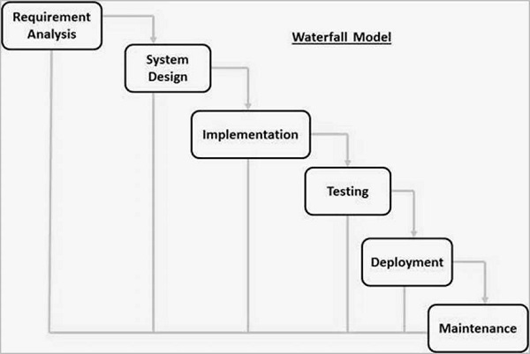

Slide 36
The sequential phases in Waterfall model are
Requirement Gathering and analysis − All possible requirements of the system to be developed are captured in this phase and documented in a requirement specification document.
System Design − The requirement specifications from first phase are studied in this phase and the system design is prepared. This system design helps in specifying hardware and system requirements and helps in defining the overall system architecture.
Implementation − With inputs from the system design, the system is first developed in small programs called units, which are integrated in the next phase. Each unit is developed and tested for its functionality, which is referred to as Unit Testing.
Integration and Testing − All the units developed in the implementation phase are integrated into a system after testing of each unit. Post integration the entire system is tested for any faults and failures.

Slide 37
Deployment of system − Once the functional and non-functional testing is done; the product is deployed in the customer environment or released into the market.
Maintenance − There are some issues which come up in the client environment.
To fix those issues, patches are released. Also to enhance the product some better versions are released.
Maintenance is done to deliver these changes in the customer environment.

Slide 38
Waterfall Model – Application
Every software developed is different and requires a suitable SDLC approach to be followed based on the internal and external factors. Some situations where the use of Waterfall model is most appropriate are −
Requirements are very well documented, clear and fixed.
Product definition is stable.
Technology is understood and is not dynamic.
There are no ambiguous requirements.
Ample resources with required expertise are available to support the product.
The project is short.

Slide 39
Waterfall Model – Advantages
Simple and easy to understand and use
Easy to manage due to the rigidity of the model. Each phase has specific deliverables and a review process.
Phases are processed and completed one at a time.
Works well for smaller projects where requirements are very well understood.
Clearly defined stages.
Well understood milestones.
Easy to arrange tasks.
Process and results are well documented.

Slide 40
Waterfall Model – Disadvantages
The major disadvantages of the Waterfall Model are as follows −
No working software is produced until late during the life cycle.
High amounts of risk and uncertainty.
Not a good model for complex and object-oriented projects.
Poor model for long and ongoing projects.
Not suitable for the projects where requirements are at a moderate to high risk of changing. So, risk and uncertainty is high with this process model.
It is difficult to measure progress within stages.
Cannot accommodate changing requirements.
Adjusting scope during the life cycle can end a project.
Integration is done as a "big-bang. at the very end, which doesn't allow identifying any technological or business bottleneck or challenges early.

Slide 41
System Design
TABLE STRUCTURE
Column name | Data type | size | constraint
username | varchar | 250 | not null
password | varchar | 250 | Not null

Slide 42
Category Table
Column name | Datatype | size | constraint
id | int | 11 | primary key
cat_name | varchar | 250 | null
description | varchar | 250 | null
add_date | timestamp |  | null

Slide 43
Customer Table
Column_name | Data_type | size | constraint
cust_id | int | 11 | primary key
cust_name | varchar | 250 | not null
cust_email | varchar | 250 | not null
contact | int | 11 | not null
address | varchar | 250 | not null
add_date | timestamp |  | not null

Slide 44
Product Table
Column_name | Data_type | size | constraint
p_id | int | 11 | primary key
product_name | varchar | 250
category | varchar | 250
description | varchar | 250
rate | double
qty | int | 11
add_date | timestamp

Slide 45
Transaction Table
Column_name | Data_type | size | constraint
trans_id | int | 11 | primary key
cust_id | int | 11 | foregin key
p_id | int | 11 | foregin key
rate | double |  | not null
qty | int | 11 | not null
total | double |  | not null
discount | int | 11 | not null
trans_date | timestamp |  | not null

Slide 46
User table
Column_name | Data_type | size | constraint
User_id | Int | 11 | Primary key
Username | Varchar | 250 | Not null
Password | Varchar | 250 | Not null

Slide 47
DATA DICTIONARY
Data Element | Data Type | Size | Constrai nt | Alias | Data Store | Description
Admin_id | Int | 11 | Primary key | - | Admin | It store admin unique id. Identification which store registration table.
username | varchar | 250 |  |  | Admin | Username store
Password | Varchar | 250 |  |  | Category | It contain admin password
Id | Int | 11 | Primary key |  | Category | Category unique id
Cat_name | Varchar | 250 |  |  | Category | Category name
Description | varchar | 250 |  |  | Category | Category description

Slide 48
Add_date | Timesta mp |  |  |  |  | Category add date
P_id | Int | 11 | Primary key |  | Product | Product primary id
Product_name | varchar | 250 | Unique key |  | Product | Product name
Category | varchar | 250 | Foreign key |  | Product | Category data comes from category table
Description | varchar | 250 |  |  | Product | Product description
Rate | Decimal |  |  |  | Product | It store decimal product amount

Slide 49
Qty
Add_date
User_id
User name
password

Slide 50
DATA FLOW DIAGRAM
A data-flow diagram is a way of representing a flow of data through a process or a system.
Data flow diagrams are used to graphically represent the flow of data in a business information system.
The DFD also provides information about the outputs and inputs of each entity and the process itself.
A data-flow diagram has no control flow, there are no decision rules and no loops.
Data Flow Diagram represent detailed and well explained diagram of system components
DFD describes the processes that are involved in a system to transfer data from the input to the file storage and reports generation.

Slide 51
USER LEVEL DFD
USER DETAI DETAILS
DEPARTMENT BILLING
SYSTEM
DATA BASE
USER

Slide 52
DETAIL
USER
LOGIN
REGISTER

Slide 53
ADMIN
USER DRTAIL USER DETAIL
DEPARTMENT BILLING
SYSTEM
DATA BASE
ADMIN
REPORT REPORT

Slide 54
ZERO LEVEL DFD
Product
management
Purchase
management
Inventory
management
Department billing
system
Stock
management
Sale
management
Discount
management

Slide 55
Generate product report
Product management
Generate
Sale report
Sale
management
Department
Billing
system
Generate
Discount report
Discount management
Generate inventory report
Payment management
Generate stock report
Inventory management
Generate payment
report
Stock management

Slide 56
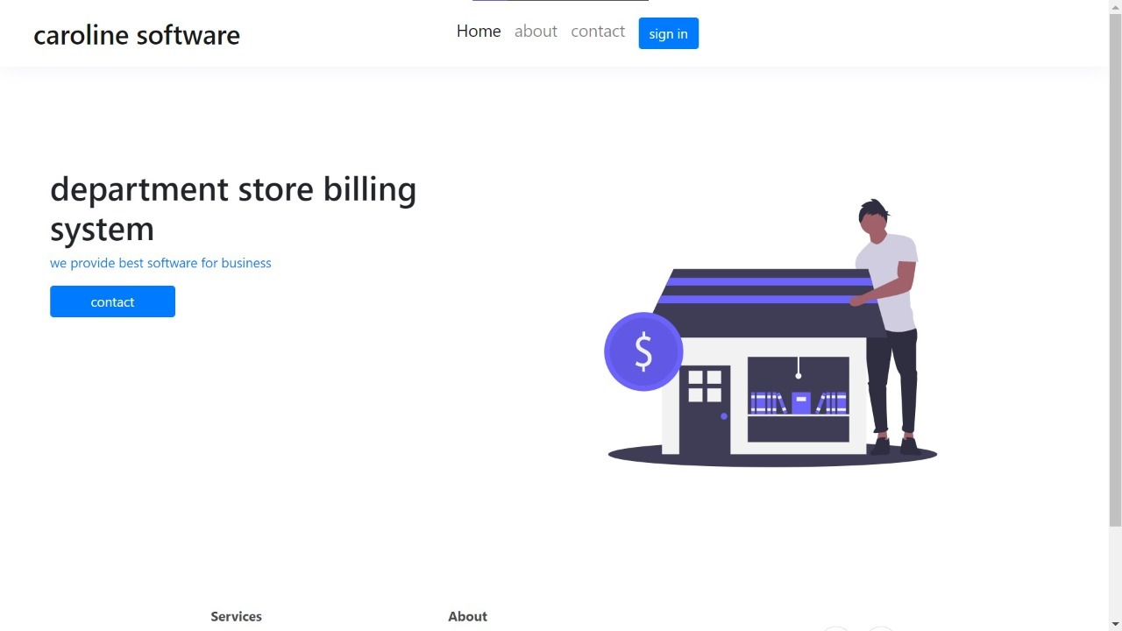
SCREEN LAYOUT
Home page:
The home page shows the interface of the department store billing system and its different functionality.

Slide 57
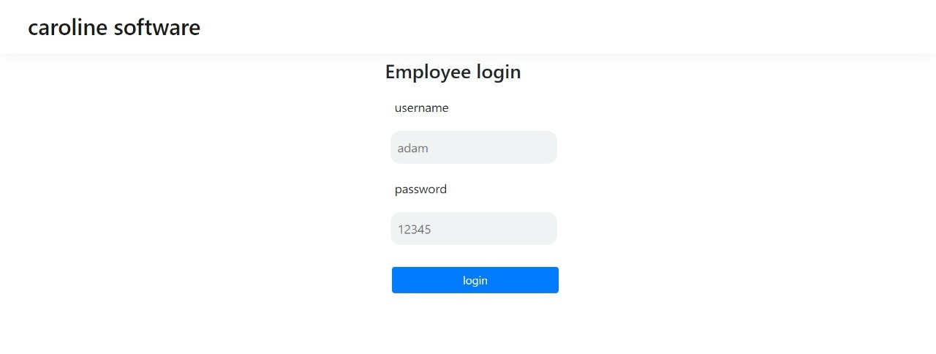
Employee Login page
The main screen will contain the login page (See Figure). The login page consists of Register link, Email Id, password, and the login button. It consists of two text boxes that are Email Id, password . There is also a submit button with the value login.

Slide 58
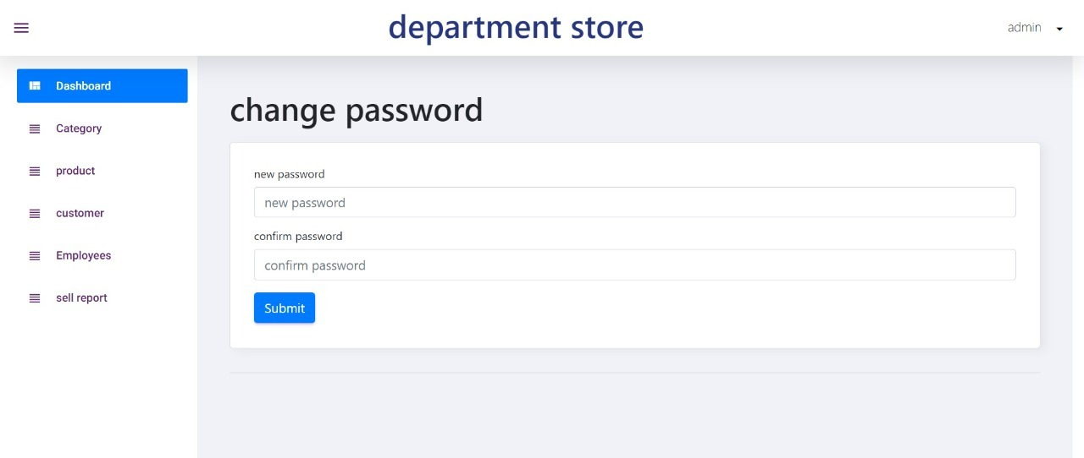
Change password
This feature enables the user to change his password.
If the user think that someone else also know his or her password.
using this option he or she can change their password. easily
which restricts the unknown user to login his his or her account

Slide 59
ADMIN SIDE
Admin is administration of website. He/she will manage the website details and Perform some insert, update and delete operation.
Admin only works on admin side and user side .he will manage all the information and data.

Slide 60
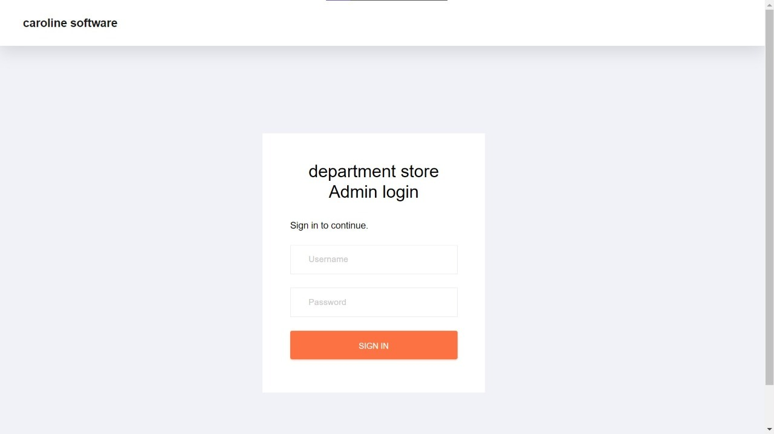
Admin login

Slide 61
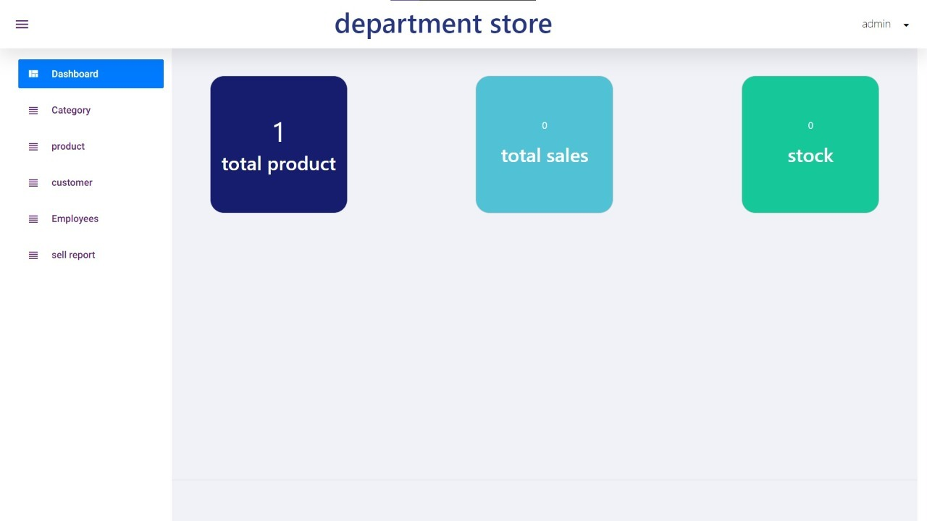
Dash board

Slide 62
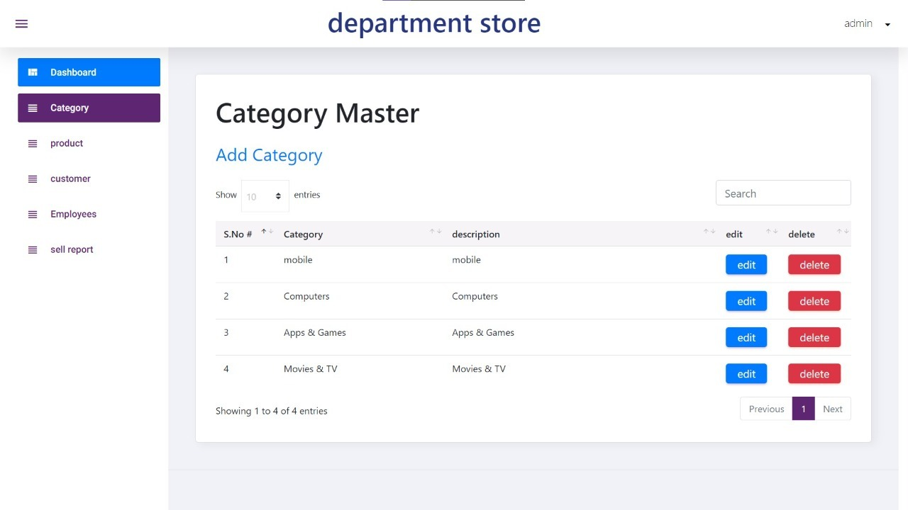
USER SLIDE

Slide 63
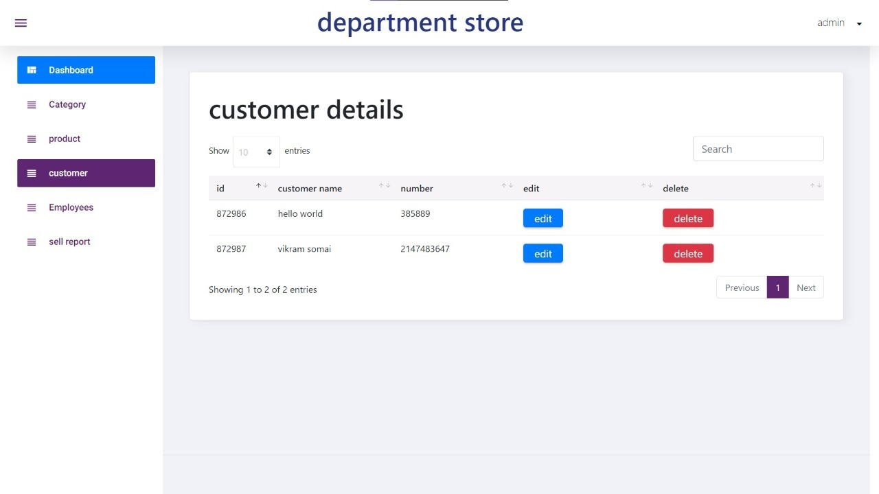
USER REPORT
customer details
This provides over all details of the customer who has purchased any item from the store. This session store all the confidential detail of the user

Slide 64
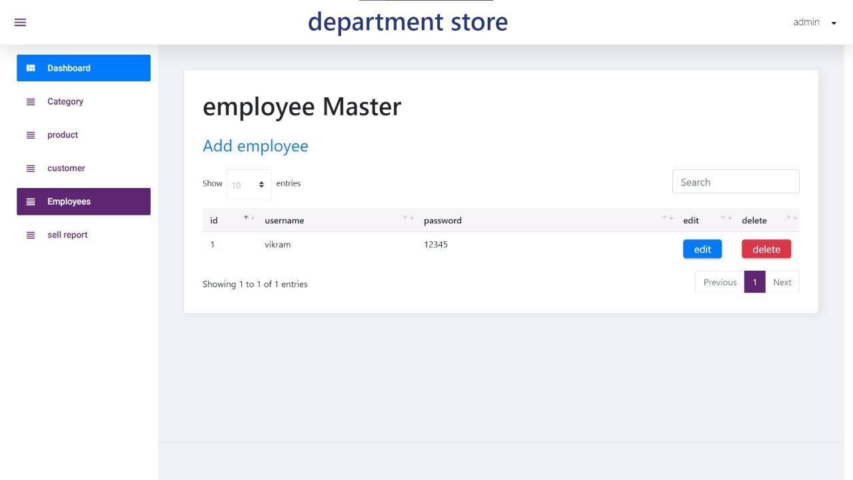
Employee

Slide 65
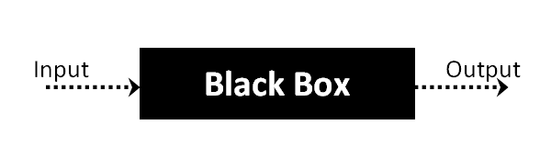
System Testing
Black Box Testing
Black Box Testing is a software testing method in which the functionalities of software applications are tested without having knowledge of internal code structure, implementation details and internal paths. Black Box Testing mainly focuses on input and output of software applications and it is entirely based on software requirements and specifications

Slide 66
The above Black-Box can be any software system you want to test. For Example, an operating system like Windows, a website like Google, a database like Oracle or even your own custom application.
Under Black Box Testing, you can test these applications by just focusing on the inputs and outputs without knowing their internal code implementation.

Slide 67
Types of Black Box Testing
There are many types of Black Box Testing but the following are the prominent ones -
Functional testing - This black box testing type is related to the functional requirements of a system; it is done by software testers.
Non-functional testing - This type of black box testing is not related to testing of specific functionality, but non-functional requirements such as performance, scalability, usability.
Regression testing - Regression Testing is done after code fixes, upgrades or any other system maintenance to check the new code has not affected the existing code.

Slide 68
Tools used for Black Box Testing
Tools used for Black box testing largely depends on the type of black box testing you are doing.
For Functional/ Regression Tests you can use - QTP, Selenium
For Non-Functional Tests, you can use - LoadRunner, Jmeter

Slide 69
White Box Testing
White Box Testing is software testing technique in which internal structure, design and coding of software are tested to verify flow of input-output and to improve design, usability and security. In white box testing, code is visible to testers so it is also called Clear box testing, Open box testing, Transparent box testing, Code-based testing and Glass box testing.
The term "White Box" was used because of the see-through box concept. The clear box or White Box name symbolizes the ability to see through the software's outer shell (or "box") into its inner workings

Slide 70
White Box Testing Tools
Below is a list of top white box testing tools.
Parasoft Jtest
EclEmma
NUnit
PyUnit
HTMLUnit
CppUnit

Slide 71
FUTURE ENHANCEMENT
1) This project will help the store keeper in fast billing.
2. This project enable store keeper to maintain a great database of all Customers
3) customer who have visited the store and have purchased which product can be known easily
4) this enables to see report regarding product and category
5) it makes it easy to maintain in future prospect

Slide 72
BIBLIOGRAPHY
https://www.javatpoint.com/php-tutorial
https://www.tutorialrepublic.com/jquery-tutorial/
https://www.tutorialspoint.com/sdlc/sdlc_waterfall_model.htm
https://www.guru99.com/unit-testing-guide.html
https://www.guru99.com/functional-testing.html
https://www.tutorialspoint.com/software_testing_dictionary/behaviour_testing.htm

